Slide 1





G8T9 Y W L T C
PM Review
Christine | Lifu | Tee Yong | Wang Ting | Yu Liang

Slide 2



Functionalities

Slide 3
Do you plan to drop/add any functionalities?
Not dropping any functionalities
Yes, we plan to add functionalities
Starting with recommended ones after completing required functions
Timetable
Search
Consideration for other functions will depend on progress

Slide 4
Do you plan to use any PHP frameworks?
Didn’t use in Iter 1 & 2
Maybe for additional features in future iterations (need to learn)

Slide 5
Did you manage to finish +3 functionalities?
Add Bid
Drop Bid
Edit Bid
View Bidding Results
Bootstrap Validation
Token Validation
Start and Clear (Round 1)

Slide 6
What is the IP address & admin password for your cloud deployment?
Admin password = P@ssw0rd!547
Cloud IP Address = 13.58.117.140/app/login.php

Slide 7
Schedule

Slide 8
Project Overall Schedule
Iteration 1 – Login + Bootstrap + Basic UI design
Iteration 2 – Bootstrap Validation, Token Validation, Add Bid, Drop Bid, Edit Bid, Start and Clear Round 1, View Bidding Results, JSON
Iteration 3 – Start and Clear Round 2, Drop Section, Develop additional features + finish UI
Iteration 4 – Fix any bugs, UI, app finalization & deployment
Iteration 5 – Final Presentation

Slide 9
Project Schedule
Iteration 1
(Login + Bootstrap)
Week 5 – Week 6
Week 7 – Week 8
Week 9 – Week 10
Week 11 – Week 13
W5
W6
W7
W8
W9
W10
W11
W12
W13
Completed
Iteration 2
(Rounds + user functionalities)
Completed
Iteration 3
(Prepare for user testing)
Not started
Iteration 4
(Develop additional features)
Not started
Iteration 5
(Finishing touch + presentation)
Not started
LEGEND
PLANNED
ACTUAL

Slide 10
Iteration 1 (17/9 – 1/10)
PLANNED TASKS
SQL + Objects & DAOs
Iteration 1
20/9
21/9
22/9
23/9
24/9
25/9
26/9
27/9
28/9
29/9
30/9
31/9 – 1/10
Completed
UI ideation & implementation
Completed
Completed
Login + database connection
Completed
Main page + Logout
Completed
Bootstrap & Testing
HOLD
HOLD
Completed
Completed
Deployment + PM Review
Completed
LEGEND
SCHEDULED
ACTUAL

Slide 11
Iteration 2 (2/10 – 15/10) (PLANNED)
LEGEND
PLANNED
ACTUAL
PLANNED TASKS
Token
Validation
Iteration 2
2/10 – 3/10
4/10
5/10
6/10
7/10
8/10
9/10
10/10
11/10
12/10
13/10
14/10 – 15/10
Plan
Bootstrap
Validation
Plan
Add Bid
Plan
Edit & Drop Bid
Plan
Start & Clear Round
Plan
View Bidding Result
Plan
JSON
Plan
Drop Section
Plan
Deployment & Testing
Plan

Slide 12
Iteration 2 (2/10 – 15/10) (ACTUAL)
LEGEND
PLANNED
ACTUAL
PLANNED TASKS
Token
Validation
Iteration 2
2/10 – 3/10
4/10
5/10
6/10
7/10
8/10
9/10
10/10
11/10
12/10
13/10
14/10 - 15/10
Completed
Bootstrap
Validation
Completed
Add Bid
Completed
Edit & Drop Bid
Completed
Start & Clear Round
Completed
Completed
View Bidding Result
Completed
JSON
Completed
Deployment & Testing
Completed

Slide 13
Iteration 3 (16/10 – 29/10)
LEGEND
PLANNED
ACTUAL
PLANNED TASKS
Additional features
Iteration 3
16/10
17/10
18/10
19/10
20/10
21/10
22/10
23/10
24/10
25/10
26/10-27/10
28/10 - 29/10
Organizing, tidying up
Drop Section
JSON Test Cases
Start Round 2
Testing
Deployment

Slide 14
Iteration 4 (30/10 – 9/11)
PLANNED TASKS
Fixing features & UI
Iteration 4
30/10
31/10
1/11
2/11
3/11
4/11
5/11
6/11
7/11
8/11
9/11
Organizing, tidying up
Testing
Deployment
Preparation
LEGEND
PLANNED
ACTUAL

Slide 15
Iteration 5 (9/11 – 19/11)
PLANNED TASKS
Presentation Preparation
Iteration 5
10/11
11/11
12/11
13/11
14/11
15/11
16/11
17/11
18/11
19/11
Deployment & Submission
Presentation
LEGEND
PLANNED
ACTUAL

Slide 16
What are your milestones?
Milestone 1 – PM Review
Milestone 2 – In-class Demo
Milestone 3 – User Acceptance Test
Milestone 4 – Deployment
Milestone 5 – Final Presentation

Slide 17
Iteration 1 Critical Path
1
3
3
3.1.1
0
13
14
2
5
0
Task ID | Description | Effort
3.1.1 | Create SQL | 3
3.2.1 | Create objects & DAOs | 2
3.2.2 | Set up connection to database | 1
3.3.1 | Create Login | 1
3.4.2 | Create Main page & Logout | 3
3.4.1.2 | Create Login Page UI | 3
3.5.1.1 | Create Bootstrap without validation | 1
3.5.1.2 | Create Bootstrap with validation | 2
5 | Deployment | 2
1
3
13
14
4
5
4
4
2
3.2.1
0
1
3.2.2
1
11
12
7
9
2
3.5.1.2
0
3
3.4.1.2
3
4
5
5
5
11
12
10
12
6
1
3.3.1
0
6
7
9
10
10
3
3.4.2
0
1
3.5.1.1
0
6
6
7
9
10
10

Slide 18
Iteration 2 Critical Path (Planned)
1
2
3
5
2
3.1.1
0
3
3.6.1
2
6
5
3.6.2
2
10
Task ID | Description | Effort
3.1.1 | Token Authentication | 2
3.2.1 | Bootstrap Validation | 2
3.3.1 | Start and Clear Round | 6
3.3.2 | View Bidding Result | 2
3.5.1. | Drop Section | 1
3.6.1 | Add Bid | 3
3.6.2. , 3.6.3 | Edit and Drop | 5
3.7.1 | JSON | 5
5 | Deployment | 1
1
2
5
7
8
12
7
11
5
3.7.1
1
3
4
2
3.2.1
0
8
12
11
11
1
3.5.1
1
3
4
12
12
5
10
11
12
13
13
6
3.3.1
0
2
3.3.2
0
1
5
0
5
10
11
12
13
13

Slide 19
Iteration 2 Critical Path (Actual)
1
2
3
6
3
3.6.2, 3.6.3
3
2
3.1.1
0
4
3.6.1
3
7
9
Task ID | Description | Effort
3.1.1 | Token Authentication | 2
3.2.1 | Bootstrap Validation | 2
3.3.1 | Start and Clear Round | 6
3.3.2 | View Bidding Result | 2
3.5.1. | Drop Section | 1
3.6.1 | Add Bid | 4
3.6.2. , 3.6.3 | Edit and Drop | 3
3.7.1 | JSON | 4
5 | Deployment | 1
1
2
6
9
10
12
3
4
9
12
2
3.2.1
0
4
3.7.1
0
3
4
9
12
5
11
12
12
13
13
6
3.3.1
0
2
3.3.2
0
1
5
0
5
11
12
12
13
13

Slide 20
How much buffer time do you have?
6 days

Slide 21
Bug Metrics

Slide 22
Total: 27
Bug Metrics
(Iter 1)
S/N | Description | Severity | Status
1 | UI - Poor visibility for login page (black text on dark purple BG) | 1 – Low | Resolved
2 | ProcessLogin - Process login failed to redirect to targeted page | 5 – High | Resolved
3 | Bootstrap - Checked wrong columns for pre-requisite.csv | 5 – High | Resolved
4 | Bootstrap – errors output not sorted accordingly to requirements | 1 – Low | Resolved
5 | Login (admin) - No logout button in bootstrap.php after admin login | 5 – High | Resolved
6 | Bootstrap – does not work on AWS | 10 - Critical | Unresolved

Slide 23
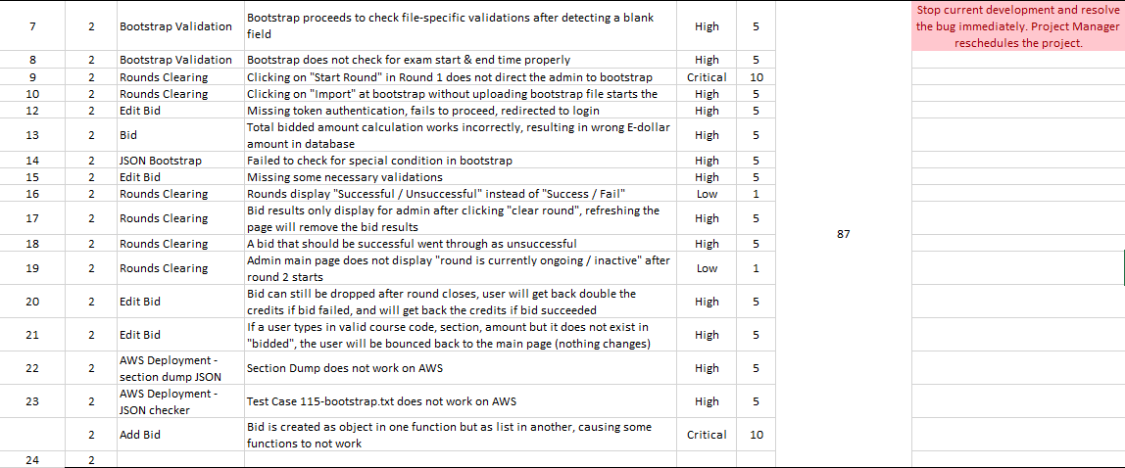
Total: 87
Bug Metrics
(Iter 2)

Slide 24
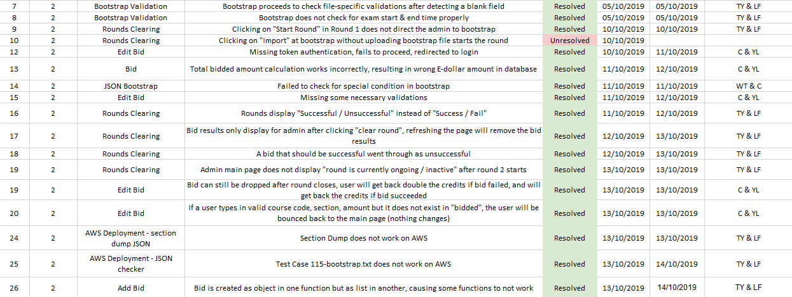
Bug Metrics
(Iter 2)
Current: 5

Slide 25
Roles & Responsibilities

Slide 26
Iteration 1 – Roles & Responsibilities
Project Manager – Huang Lifu
Coding Team 1 – Yu Liang & Tee Yong
Coding Team 2 – Wang Ting & Christine

Slide 27
Iteration 2 – Roles & Responsibilities
Project Manager – Wang Ting
Coding Team 1 – Yu Liang & Christine
Coding Team 2 – Li Fu & Tee Yong

Slide 28
Pair Programming Teams & Rotation Plan

Slide 29
Pair Programming Teams & Rotation Plan
Iteration | Project Manager | Programming Pairs
1 | Lifu | Yu Liang & Tee Yong Wang Ting & Christine
2 | Wang Ting | Lifu & Tee Yong Yu Liang & Christine
3 | Christine | Yu Liang & Lifu Tee Yong & Wang Ting
4 | Tee Yong | Lifu & Christine Yu Liang & Wang Ting
5 | Yu Liang | N/A

Slide 30

Thank you!

